Slide 1
Franklin Academy BB
Science Fair 2016/2017

Slide 2
Science Fair
How do we start?
Every student will get a Science Fair Packet. Read it carefully.
Students need to pick 3 topics so the classroom teacher can approve one of them – DO NOT Start project until the teacher has approved an appropriate one.
Due: Oct. 31, 2017
Changes if Any Due: November 4

Slide 3
Next Step
Now I have a topic approved, what next?
Students have learned the scientific method in class so they will be able to complete each portion of the project. (Purpose, Hypothesis, Procedure, Materials, Observation, and Conclusion)
Work on the approved science project. DO NOT buy a big science tri-board. A project poster paper will be given to all the students by the school.
Hypothesis Due: Nov. 7, 2017
Material and Procedure Due: Nov. 14, 2017
Do experiment 3 times over Thanksgiving Break
Conclusion Due: Dec. 16, 2017

Slide 4
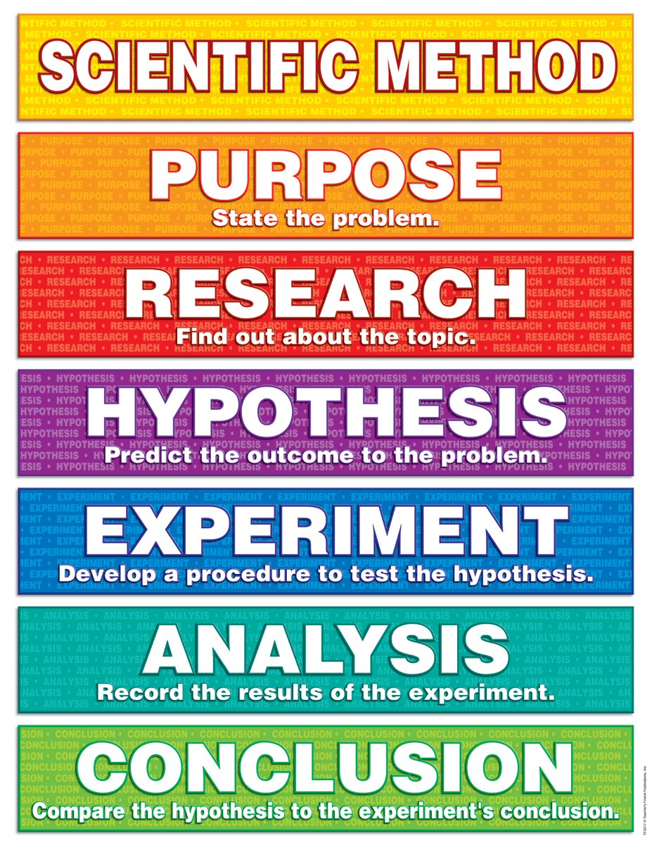
Complete the Steps
How do we complete the Scientific Method steps?
There are worksheets provided in your packet – read it carefully.
The teacher will provide the lesson in class so your child can complete the appropriate section by the due date listed in the packet.
The teacher will correct any mistakes and the student can continue upon teacher approval.

Slide 5
Must remember to…
The project must fold flat – NO 3-D items on the board
The board must be on the provided paper board that was pre-folded
No pictures of the student(s) displayed on the board – pictures can be used but must only show the experiment
The name of the student must be on the back with the grade level and teacher’s name – NOT on the front of the board
Final Projects Due: Feb. 21 to present in class

Slide 6
Finished!
What do we do when we’re done?
Final projects will be designed and displayed on the provided paper and handed in for judging.
The 1st and 2nd place winners will be judged at the schools Science Fair and the winning projects will be presented to the District Fair.
All winners will be notified. The winning project will be transferred to a big tri-fold project board.

